Slide 1
Anomalies detection in crop health and creating a custom flight path Group 15
Git hub URL: https://github.com/123sashank321/Anamolies_Detection_in_Crops
Sites.google : https://sites.google.com/view/anamolies-detection-in-crops/home
Professor: T Senthil Kumar(CSE)
Collaborator: Akash (SKYX)

Slide 2
Agenda
Block Diagram
CNN- Proposed Architecture
CNN Algorithm
Dataset description
Hyperparameter List
Performance Metrics
Hyperparameter Tuning
Comparison of Architecture
Poster
Explainable AI

Slide 3
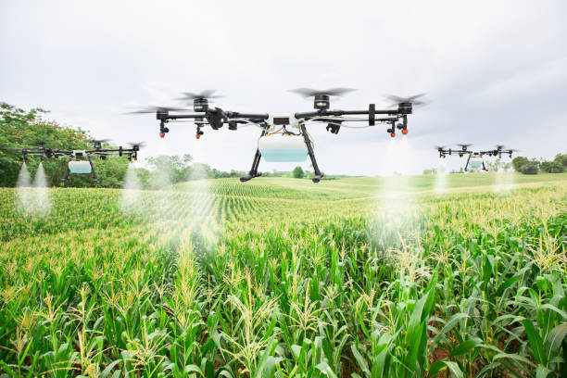
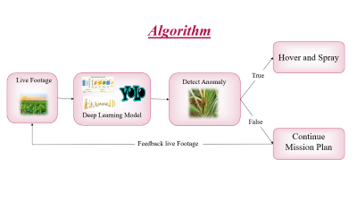
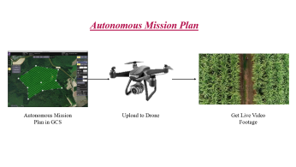
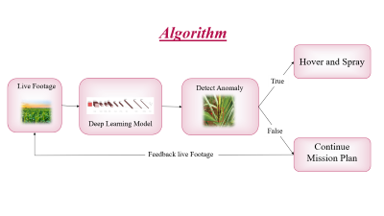
Block Diagram
Autonomous Mission Plan
Output
AI and Algorithm

Slide 4
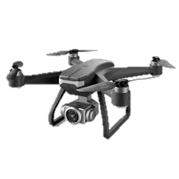
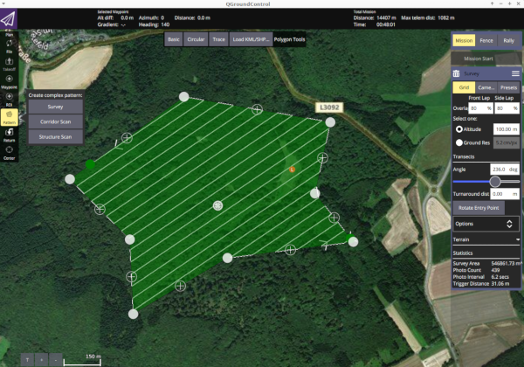
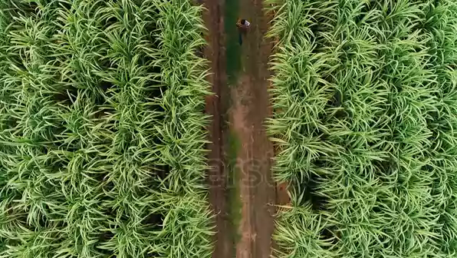
Autonomous Mission Plan
Autonomous Mission Plan in GCS
Upload to Drone
Get Live Video Footage

Slide 5
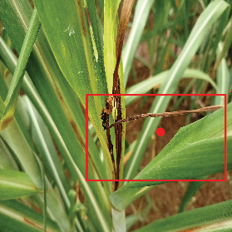
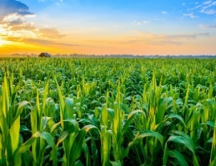
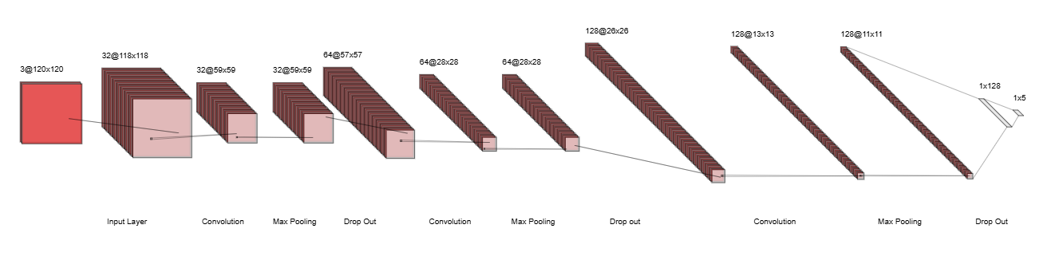
Algorithm
Hover and Spray
True
Live Footage
Detect Anomaly
Deep Learning Model
False
Continue Mission Plan
Feedback live Footage

Slide 6
CNN –Proposed Architecture (Drawn using tool).

Slide 7
CNN –Algorithm.
Data Preparation:
Preprocess Data: Normalize, resize, and split data into training, validation, and test sets and data augmentation.
Define CNN Architecture:
Input Layer: Specify input shape (e.g., image dimensions).
Convolutional Layers: Apply filters to extract features
Pooling Layers: Reduce spatial dimensions
Flattening: Flatten the output from convolutional layers.
Fully Connected Layers: Dense layers for classification
Output Layer: Define output layer based on the taskn).
Compile the Model:
Loss Function: Choose appropriate loss function
Optimizer: Select an optimizer
Metrics: Define performance metrics).
Train the Model:
Fit: Train the model with training data and validate using validation data
Evaluate the Model:
Test: Assess performance on test data
Make Predictions:
Predict: Use the trained model for predictions .
Calculation of Metrics:
Precision, recall, F1-score , confusion matrix, etc
Evaluate and tune hyperparameter
Save the model.

Slide 8
Images Related to project
There are totally 5 classes in our project, out of which 4 corresponds to diseased sugarcane and the other being healthy one.
Healthy
Mosaic
Red Rot
Rust
Yellow
Unhealthy

Slide 9
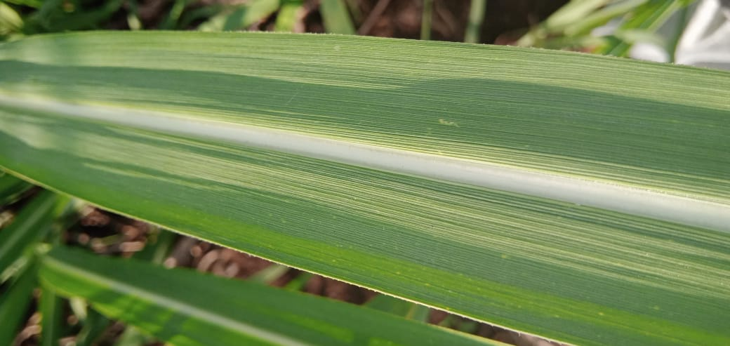
Healthy Plant

Slide 10
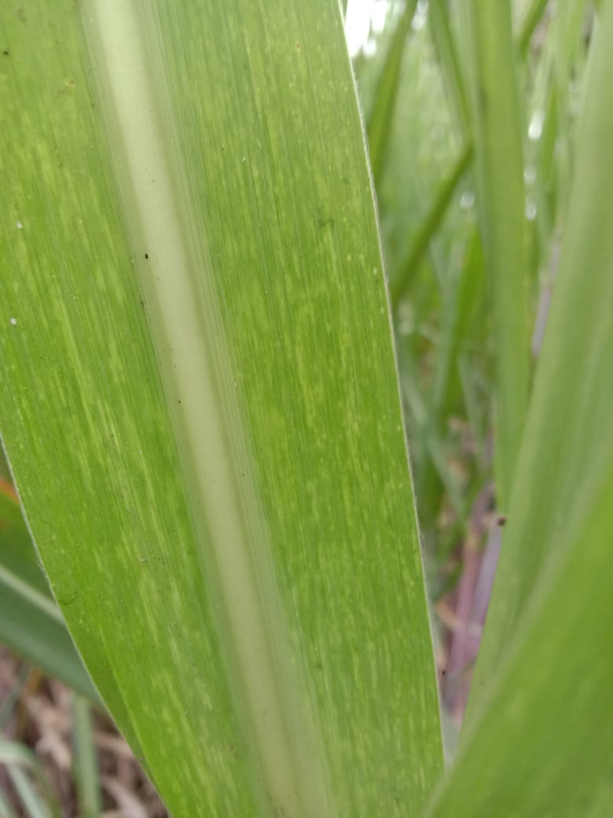
Mosaic Disease

Slide 11
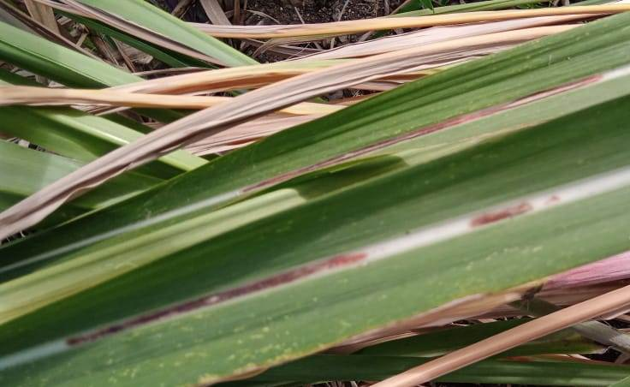
Red Rot Disease

Slide 12
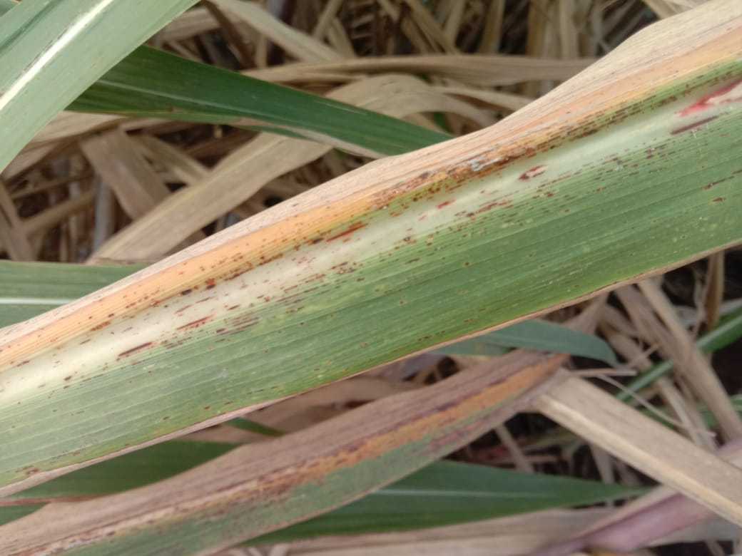
Rust Disease

Slide 13
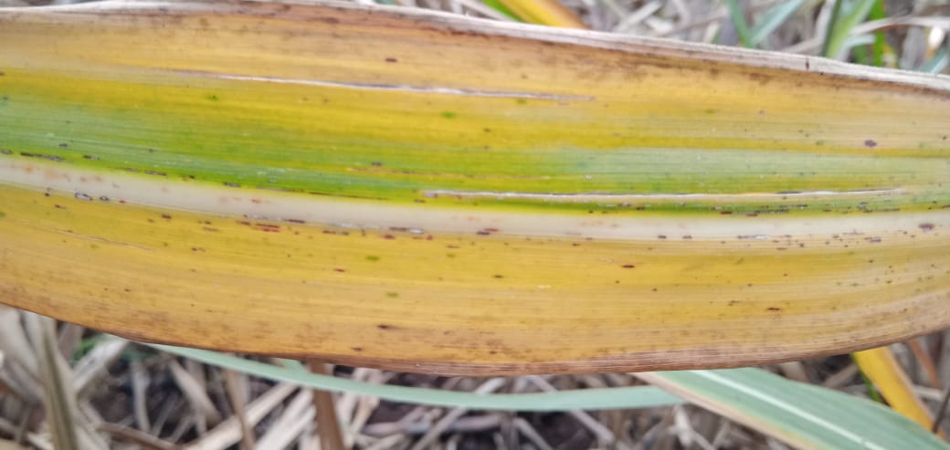
Yellow leaf Disease

Slide 14
Hyperparameter List.
Hyper Parameter Category | Hyperparameter | Value
Architecture Hyperparameters | Number of filters | (32,64,128)
 | Kernel Size | (3,3)
 | Dropout | 0.2
 | Activation functions | ‘relu’, ‘softmax’ (for final dense layer alone)
Training Hyperparameters | Batch Size | 32
 | No.of Epochs | 20
 | Optimizer | ‘adam’
Data Augmentation | Rotation Range | 20 degrees
 | Width Shift Range | 0.1
 | Height Shift Range | 0.1
 | Augmentation Techniques | Flip,Rotate, Scale&crop, Gaussian Noise, Contrast Adjustment
Performance Metric for Training | Metric | Accuracy
Data Split | (Train,Test,Validation) | (70,20,10)

Slide 15
Proposed Split Ratio of the Dataset

Slide 16
Performance Metrics
Mean Squared Error
Class 1 | 0.09209407764239161
Class 2 | 0.09634457353357892
Class 3 | 0.06772456786625106
Class 4 | 0.08699348257296685
Class 5 | 0.04788892037404364
Mean Absolute Error
Class 1 | 0.09209407764239161
Class 2 | 0.09634457353357892
Class 3 | 0.06772456786625106
Class 4 | 0.08699348257296685
Class 5 | 0.0478889203740436
 | Precision | Recall | F1- Score
Class 1 | 0.73 | 0.87 | 0.8
Class 2 | 0.74 | 0.75 | 0.74
Class 3 | 0.88 | 0.78 | 0.83
Class 4 | 0.8 | 0.76 | 0.78
Class 5 | 0.9 | 0.85 | 0.88
The precision, recall, and F1-score metrics for each class highlight the model's performance in distinguishing between different categories. Class 5 exhibits the highest scores across all metrics, indicating robust predictive capabilities, while Class 2 has the lowest precision and F1-score, suggesting it struggles the most in terms of accurate classification. Overall, the model performs well, particularly for Class 3 and Class 5, but there is room for improvement in Class 2 to enhance overall classification effectiveness.
The Mean Squared Error (MSE) and Mean Absolute Error (MAE) values indicate the performance of your model across five classes, with Class 5 demonstrating the lowest error rates in both metrics, suggesting it is the best-performing class. In contrast, Class 2 has the highest MSE and MAE values, indicating that it presents the most significant challenge for the model. Overall, the error metrics suggest that while the model performs reasonably well, there is potential for improvement, especially in accurately predicting Class 2.

Slide 17
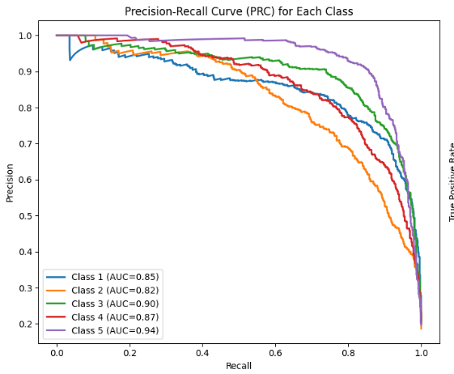
Performance Metrics (70,20,10)
The Precision-Recall Curve shows strong performance for Class 5 (AUC = 0.94) and Class 3 (AUC = 0.90), indicating effective identification of these classes. Classes 1 and 4 also perform well, while Class 2 has the lowest AUC (0.82), suggesting room for improvement. Generally, the model demonstrates a good balance between precision and recall, especially for higher-performing classes. Targeted enhancements for Class 2 could further boost overall classification performance.

Slide 18
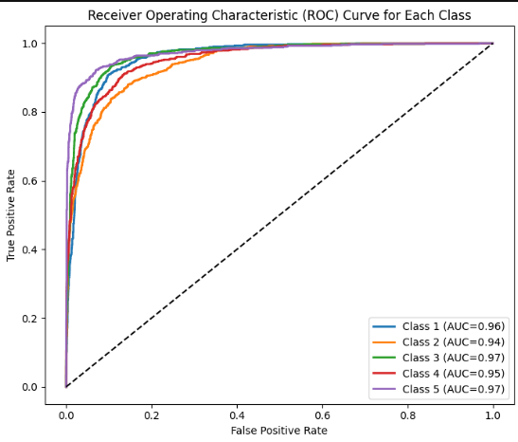
Performance Metrics (70,20,10)
The ROC curves for each class are all very close to the top left corner of the graph, indicating that the model has high accuracy in predicting each class. The AUC scores for each class are all above 0.9, which means that the model has a high ability to distinguish between the different classes. Class 3 has the highest AUC score of 0.97, indicating that it has the highest accuracy in predicting the correct class. Overall, the ROC curves show that the model is performing well at distinguishing between all five classes.

Slide 19
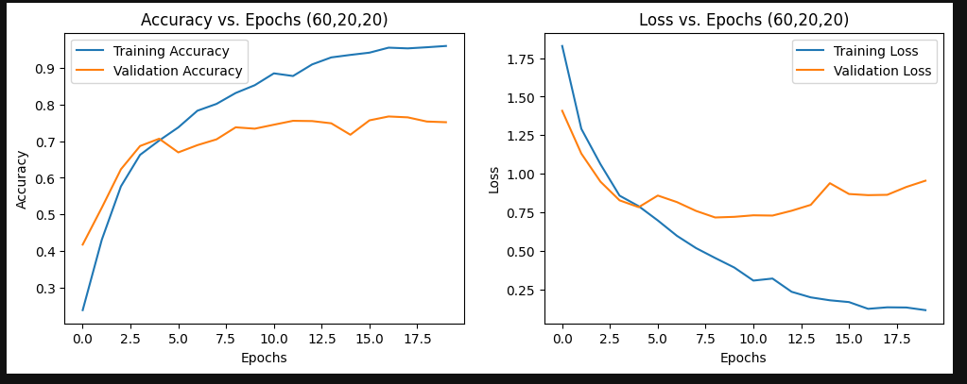
Hyperparameter Tuning:
The above set of graphs are presented for split of (60,20,20) data split. But the results seemed to not converge due to overfitting. To counter this 2 measures were taken:
Data Augmentation
Larger amount of training data (70,20,10) split.
By doing Data Augmentation the original number of pictures 2016 changed to 15216 images and different parameters of the image have been changed.

Slide 20
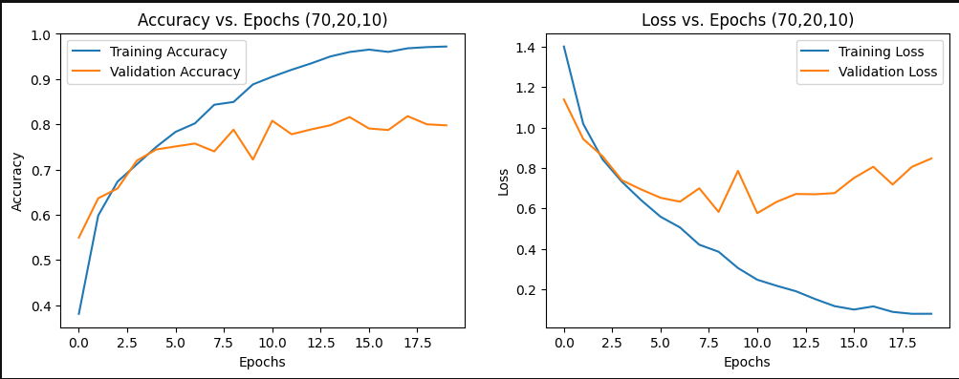
Hyperparameter Tuning:
The data still had a little bit of overfit.

Slide 21
Comparison of Architecture
Feature | CNN (Convolutional Neural Network) | RCNN (Region-based Convolutional Neural Network) | YOLO (You Only Look Once)
Purpose | General feature extraction and image classification | Object detection by selecting regions and classifying them | Real-time object detection
Architecture | Convolutional layers followed by pooling and dense layers | Selective search to find region proposals, then CNN for classification | Single-stage, unified detection and classification
Speed | Moderate | Slow due to multiple region proposals and CNN applications | Very fast, suitable for real-time applications
Output Type | Classification score | Bounding boxes around proposed regions and class probabilities | Bounding boxes with class probabilities
Use Case | Image classification, object recognition | Object detection where speed is not the main constraint | Real-time object detection in dynamic environments
Detection Accuracy | High for classification tasks | High accuracy in detecting small or overlapping objects | High for medium-sized objects; struggles with small objects
Limitations | Limited to classification, poor at localization | Slow in processing, high computational cost | Challenges with overlapping objects and smaller detection

Slide 22
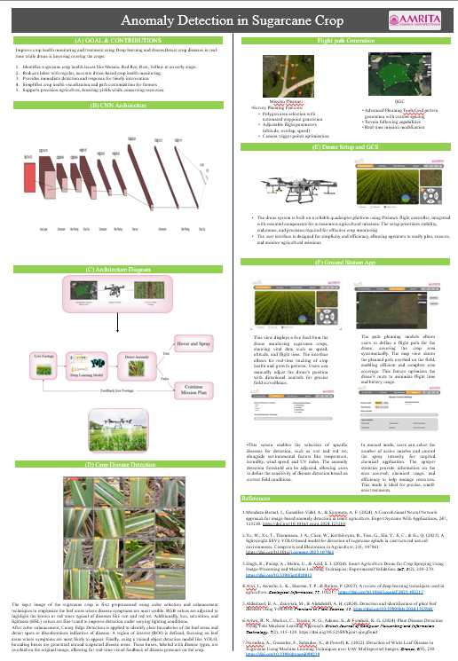
Poster

Slide 23
Explainable AI:
Explainable AI (XAI) is an approach to make AI models' decision-making processes transparent and understandable for humans.
Crop Anomaly detection and XAI:
Explainable AI (XAI) can enhance crop anomaly detection by providing transparent insights into the reasons behind detected irregularities, such as pests, diseases, or nutrient deficiencies, across crop fields. In crop anomaly detection, AI models analyze data from sources like satellite images, drones, and sensors to identify unusual patterns in crop health. Using XAI, these models can reveal which specific features—such as soil moisture, temperature, vegetation indices, or color changes—contributed to the anomaly prediction, allowing farmers to understand the underlying causes and take targeted actions. XAI thus enables agronomists and farmers to trust and interpret AI-driven insights, supporting timely, data-informed decisions to protect crop yields

Slide 24
Thank You

